Slide 1

SKYWARD CONSTRUCTION GROUP
1 COURT BUILD-OUT
SKYWARD CONSTRUCTION GROUP
1 COURT BUILD-OUT
Pickleball Kingdom - Royal Point

Slide 2

Increased Efficiency
1
2
3
4
5
Define
Measure
Analyze
Improve
Execute
Suggest improvements like matching materials, staging better, and getting new equipment.
Identify the layout and requirements of one complete court.
Record all data needed to build one full court from start to finish.
Conduct time studies to track labor and inefficiencies, create a BOM, and document equipment usage.
Implement changes and track progress using clear Key Performance Indicators.
Notes:
“This slide walks through how we’ve evaluated and refined our process using the Define, Measure, Analyze, Improve, and Execute framework.
Define “We begin by clearly defining the layout and requirements of a complete court which ensures alignment across teams and allows us to build with consistency.”
Measure “Next, we focus on measuring necessary inputs—from materials and equipment to time and laborto give us a strong baseline for evaluating any performance.”
Analyze “With that data in hand, we analyze trends in labor flow, material movement, and equipment use. Creating a BOM and conducting time studies helped us better understand where we could increase efficiency.”
Improve “Based on analyzed insights, we can identify opportunities to enhance workflow—like pre-matching materials, staging them more effectively, and ensuring the right tools are available at the right time.”
Execute “Finally, we execute by implementing those changes and tracking results using clear KPIs. Allowing us to stay proactive, make informed adjustments, and continue improving as we scale.”
“Overall, this framework provides a structured way to build smarter, move faster, and maintain quality across all projects moving forward.”

Slide 3
Royal Point
Specific Observations
Royal Point
Specific Observations

Slide 4
Labor Costs Associated with Unplanned Budget Overages
Task | Cause | Labor Hours | Crew Size | Hourly Rate | Labor Cost
Fencing Inefficiencies | Movement due to early delivery and measurements; fence cutting | 3 | 1 | $30.00 | $90.00
High Bay Light Assembly | Adding connectors causes delays | 52.38 | 1 | $85.00 | $4,452.30
Sliding Door Repair | Reconstruction of glass door | 4 | 2 | $30.00 | $240.00
LVT Hauling | 13 boxes relocated to Centerville | 1.5 | 2 | $30.00 | $90.00
Hardware Store Runs | Materials not on site on time | 0.67 | 2 | $30.00 | $40.20
Total Extra Labor Cost |  |  |  |  | $4,912.50
Notes:
hailey

Slide 5
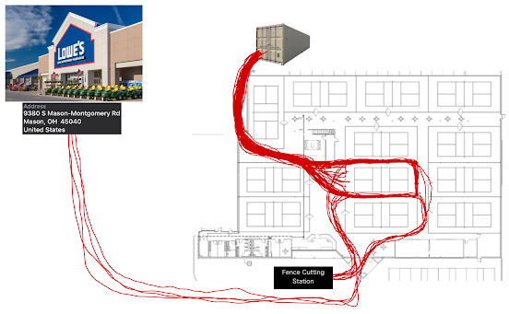
Fence Installation
Task | Quantity | Average Time (min) | Total Time Spent
Moving fences from conex to court | 26 | 3 | 78
Measuring fence to cut | 5 | 1 | 5
Cutting fence | 5 | 11 | 55
Trip to Lowes | 3 | 40 | 120
 |  | Total Time | 4h 18m
*this study captures potential inefficiencies, not total fence installation time
Total Driving Distance: 7.2 Miles
Total Walking Distance: 1.2 Miles
Notes:
karissa

Slide 6
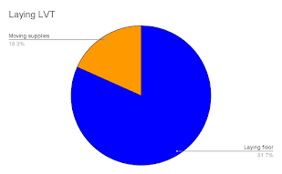
Scheduling Observations -
Fence Delivery Case Study
Task | Start time | End time | Time
Laying floor | 8:33 AM | 8:53 | 0:20
Moving fences | 8:53 AM | 9:09 AM | 0:16
Laying floor | 9:09 AM | 9:33 AM | 0:24
Moving fences | 9:33 AM | 9:38 AM | 0:05
Laying floor | 9:38 AM | 10:28 AM | 0:50
Early fence delivery blocked access, causing 21 minutes (18%) of lost time. A just-in-time approach could have reduced labor by 20% on this 300 sq ft area.
Metric | Value
Sample Area Floored (sqft) | 288
Time Spent Moving Fences (min) | 21
Time Spent Installing Flooring (min) | 94
Total Flooring Area (ft) | 3570
Waste Time per Square Foot | 0.07292
Extrapolated Total Waste Time (Hours) | 4.34
Crew Size | 2
Hourly Wage per Worker | 30
Total Wasted Labor Cost | $260.40
Cumulative Task | Total time
Laying floor | 1:34
Moving supplies | 0:21
Notes:
hailey

Slide 7
High Bay Lights
Each light takes 30 mins to assemble, adding labor costs and requiring separate connectors.
Time to Complete | Labor Rate | Labor Cost per Light | Labor Cost for RP
0:32:29 | $85.00 | $46.02 | $4,463.75
Notes:
k

Slide 8
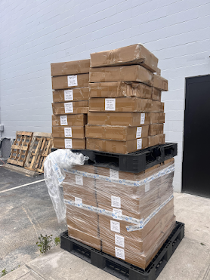
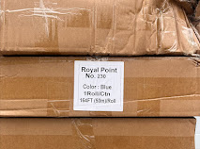
Extra Cove Base
56 additional boxes were shipped to Royal Point.
9,184 feet of extra Cove Base.
Task | Time
6/7/25 Drive to Centerville | 0.42.00
@ Centerville | 0.15.00
Drive back to RP | 0.45.00
Notes:
“This slide and the next highlights material surplus we encountered during the Royal Point project—specifically, an excess of Cove Base.”
“A total of 56 additional boxes were delivered to the site, amounting to 9,184 extra feet of material. While the product itself was in good condition and labeled for Royal Point, it exceeded the required quantity for this location.”
“To manage the overflow, we made a trip to Centerville to relocate the extra stock. As you can see in the time breakdown, the round-trip took just under 2 hours, including loading and drop-off time.”
“This scenario presents a good opportunity for us to review our ordering process and site-specific tracking to help align quantities more closely with actual job needs moving forward.”

Slide 9
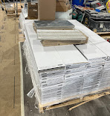
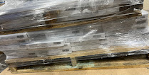
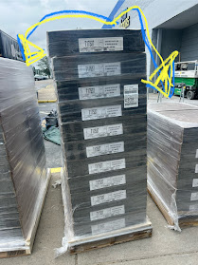
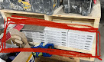
Extra Flooring
Converse Basin (Correct LVT Tile: Rustic Oak LVT Tile)
116 boxes (3,480 SF) were shipped - 102 used for Royal Point, 14 (420 SF) extra boxes redirected to Centerville.
Carpet
All 27 boxes (1,944 SF total) shipped to Royal Point - 14 boxes (1,008 SF) used on-site, 13 boxes (936 SF) required 1.5 hr round trip to Centerville. (48.15% of the carpet transported.)
Notes:
k

Slide 10
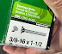
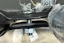


Missing Carriage Bolts
Black bolts were not delivered, requiring two 40-minute trips (6/4 & 6/11) to purchase silver replacements—resulting in $220 spent on materials that were expected to arrive.
Date | Person | Status
6/4 | Hailey | Asking for bolt tracking number
6/4 | Josh | Saying bolts have not been ordered
6/4 | Gabe | Bought bolts at Home Depot
6/6 | Gabe | Requested bolts be ordered
6/6 | Alex | Said anchor bolts were sent with fences
6/6 | Hailey | Sent pictures of incorrect bolts to Alex
Notes:
h

Slide 11
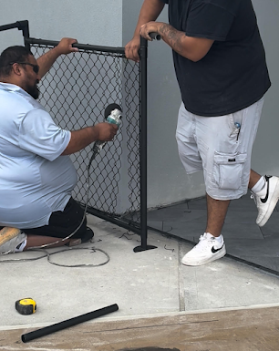
Material Waste Reduction
“We are wasting fence material by cutting it to make it work" - Tony
Fences had to must be cut to size, the excess segments - shown in the orange box - ended up as waste.
Time per fence cut: 1 Hour
Cutting fence material can result in rough edges, misalignments, or structural weaknesses—leading to a potential safety risk.
Notes:
k

Slide 12



Missing LVT Reducer Timeline
Ordered June 4th, arrived June 16th - 12 day discrepancy.
Notes:
“This is the communication timeline surrounding the LVT reducers at Royal Point, which were ordered on June 4th but did not arrive until June 16th—resulting in a 12-day gap between order and delivery.”
“During that time, multiple team members followed up requesting tracking information and confirmation whether the reducers had arrived. Despite repeated emails across several days, no one could give a clear answer on the order status.”
“This scenario shows how a relatively small material delay can create project-wide uncertainty when the communication chain breaks down. Going forward, we can work on how this important info is shared with the team in real time.”

Slide 13
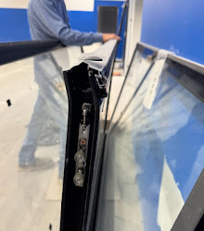
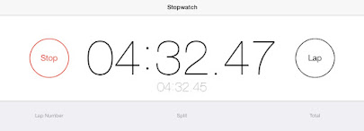
Damaged Sliding Door
One glass sliding door was damaged, requiring over 4 hours of reconstruction and assembly to repair.
($168.75 Loss)
Notes:
k

Slide 14
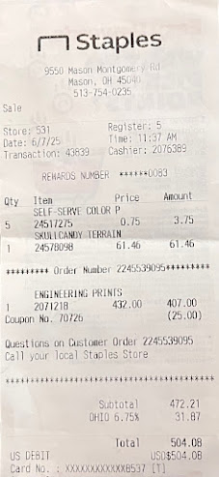
Engineering Prints
$407 was spent on updated drawings due to outdated plans being on site.
Notes:
h

Slide 15
Improved Fence Installation Process
Previous Method
Full fence runs pre-screwed together. Required repeated unscrewing during repositioning.
Improved Method
Only one pair pre-screwed at a time. Pairs shifted as needed with minimal labor.
Results Scope
Final Screwing done after accurate placement.
It can save (23 x 3) ~ 69mins of screwing time and (23 x 2) ~ 46 mins of unscrewing time.
That is about 2 hours of labor hours saved equalling to $60 saved per court.
Notes:
m

Slide 16
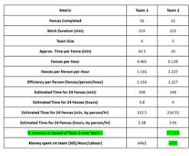
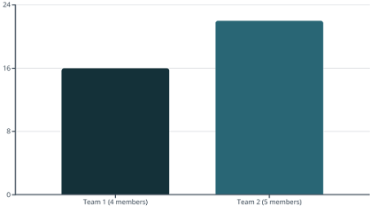
Team Efficiency Comparison
Key Findings
Both teams worked 36 hours
Team 2 used role-specific workflow
Team 2 achieved 37.36% time savings
Specialized tasks increased productivity

Slide 17
Architectural Drawing Discrepancies
Drawing A5.1
Shows larger rooms with consisting layout throughout project.
Drawings E1.0/E2.0
Display shifted outlets & reduced spaces in key areas.
Impact
Fence layout & fixture differences caused on-site delays requiring field corrections.
These inconsistencies between approved plans required immediate resolution to prevent further delays.

Slide 18
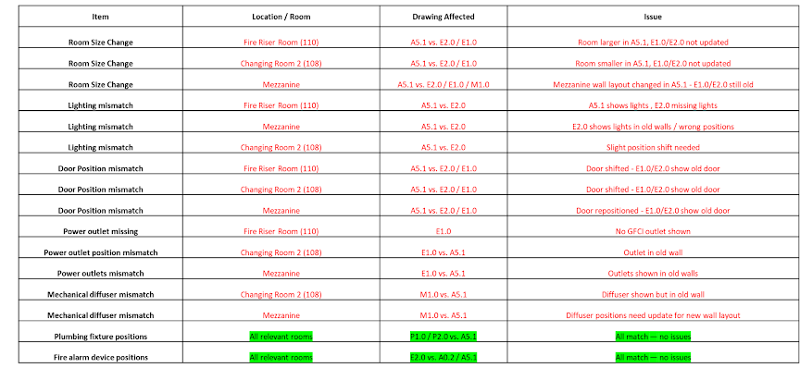
Architectural Drawing Differences

Slide 19
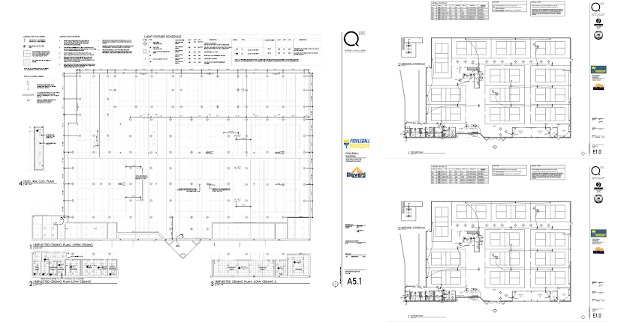
Architectural Drawing Differences

Slide 20
Final Recommendations
Team Structure Improvements
Standardize role-based workflows like Team 2
Train crews on parallel task execution
Implement specialized team assignments
Documentation Reforms
Verify architectural layouts on-site before
Adopt unified, correct master drawings
Conduct pre-construction drawing reviews.
These changes will minimize delays, reduce costs, and improve overall project execution.
Because of the drawing changes there was a delta of 2 weeks.
Unnecessary confrontation with the electrician.
Extra costs because of legal team and lawyers.

Slide 21
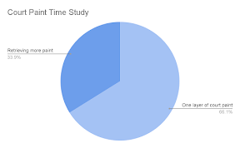
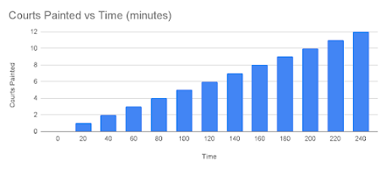
Dark Blue Court Paint -
Time Study
Task | Time
One layer of court paint of all 12 courts | 4.00.00
6/4/25: Drive to Centerville | 0.41.00
@ Centerville | 0.34.00
Drive back to RP | 0.48.00
TOTAL | 2.03.00
7 gallons of dark blue paint delivered to RP.
15 gallons of dark blue paint for one court to be completed.
In a one paint layer time study, 33.9% of the time was spent retrieving more paint due to insufficient inventory
Notes:
k

Slide 22
Inventory Spreadsheet
Notes:
k

Slide 23
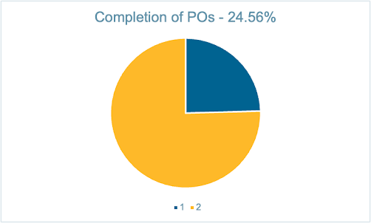
PO Status - Completion %
Status | Value | Percentage
Completed | 14 | 24.56%
Remaining | 43 | 75.44%
Total | 57 | 100%
Notes:
h

Slide 24
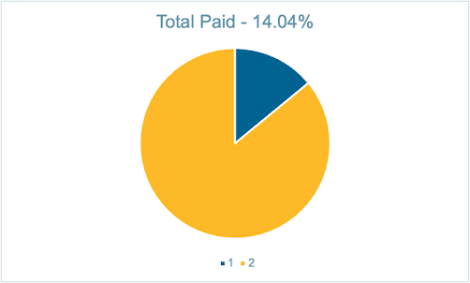
PO Status - Paid v.s. Unpaid
Status | Value | Percentage
Paid | 8 | 14.04%
Not Paid | 49 | 85.96%
Total | 57 | 100%
Notes:
h

Slide 25
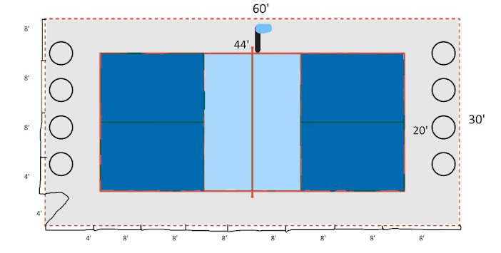
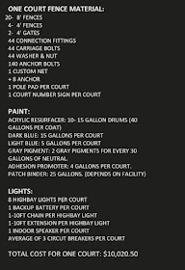
BOM Visual
Notes:
k

Slide 26
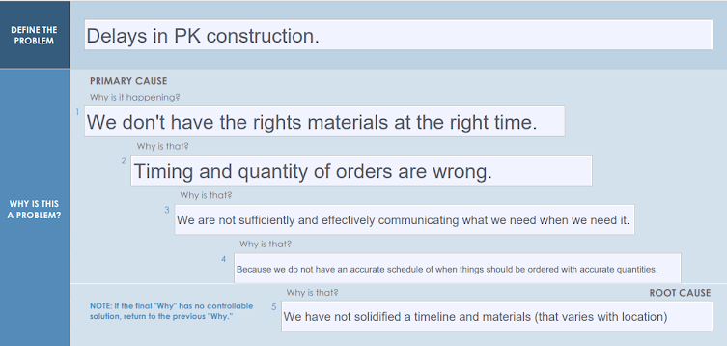
5 Whys
Recommendation: Create a comprehensive schedule for PK construction in the next 2 weeks.
Notes:
h

Slide 27
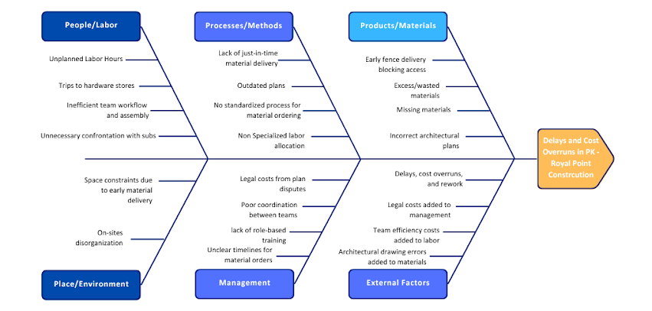
Fishbone Diagram
Notes:
m

Slide 28
Updated Fishbone Diagram Branches
1. Materials
•Early fence delivery blocking access.
•Missing materials (carriage bolts, LVT reducers).
•Excess/wasted materials (fence cuttings, extra cove base).
•Incorrect architectural plans (A5.1 vs. E1.0/E2.0) leading to material rework.
2. Labor
•Unplanned labor hours (fence movement, door repair).
•Inefficient assembly (high bay lights taking 30 mins each).
•Trips to hardware stores due to missing materials.
•Inefficient team workflows (Team 1 vs. Team 2’s 37.36% time savings gap).
•Unnecessary confrontations with subcontractors (e.g. electrician). electricians due to plan mismatches).
3. Methods/Processes
•Lack of just-in-time delivery for materials.
•No standardized process for material ordering/staging.
•Outdated engineering prints leading to rework.
•No pre-construction drawing reviews (caused 2-week delays).
•Non-specialized labor allocation (Team 1’s slower fence installation).
4. Management/Communication
•Poor coordination between teams (e.g., LVT reducers not tracked).
•Unclear timelines for material orders.
•Version conflicts in plans (A5.1 vs. E2.0 discrepancies).
•Legal costs from plan disputes (lawyer fees due to drawing errors).
•Lack of role-based training (Team 2’s efficiency proves need for specialization).
5. External Factors (New Branch)
•Subcontractor conflicts (electricians disputing plan changes).
•Legal/contractual risks (from unapproved field corrections).
•Key Additions Explained:
•Architectural Drawing Errors → Added to Materials (wrong specs) and Methods (no review process).
•Team Efficiency Data → Added to Labor (role specialization cuts time by 37.36%).
•Legal Costs → Added to Management (drawing errors triggered lawyer involvement).
•Subcontractor Conflicts → New External Factors branch (avoidable with clearer plans).
Notes:
m

Slide 29
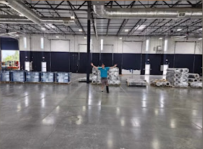
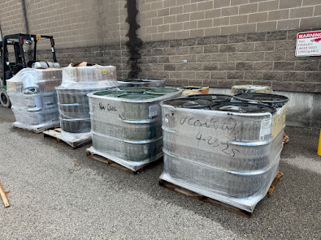
Competitor vs. Our Material Delivery
Competitor supply before install
Our supply before install
Notes:
“This slide shows a side-by-side comparison between how a competitor stages their materials before install and how our materials were delivered and stored for the same phase.”
“On the left, the competitor has all materials brought inside and organized—ready for install with minimal prep allowing the crew to start working immediately.”
“On the right, our shorthand of materials were delivered but left outside without staging. This not only delays install, since the crew has to relocate and sort materials on-site—but it also puts sensitive products like paint at risk.”
“Paint is not meant to be stored outdoors for extended periods—exposure to temp fluctuations or direct sunlight can impact its consistency and performance. If the integrity of the paint is compromised, it can lead to adhesion issues, uneven application, or even full replacement — both costing a lot of excess time and money.”
“to emphasize, the importance of timely, protected material staging is not just for convenience, but to maintain the quality of what we’re installing.”

Slide 30
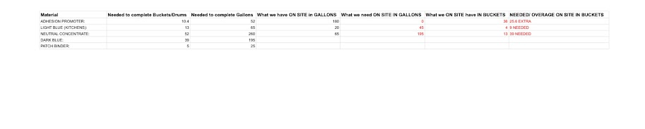
Centerville paint overages/shortages
Notes:
h

Slide 31
Capturing Bid Motion

Slide 32
Materials Needed on Site Before Each Phase

Slide 33
Rough Timeline, Extra Labor Costs

Slide 34
Court Prep-Opening Timeline

Slide 35
Labor Hours/Cost PBK with Buffer Time

